Slide 1




MINI PROJECT-2
HOUSE RENTAL SYSTEM

Slide 2


About
Project
The main objective of the projectis to provide the convenience in rental booking of Apartments for all group of People in a simple way. This project is basically Full-stack Web Project which has aim to easy booking of Apartments for the people.

Slide 3



TECHNOLOGY USED
Php
HTML
CSS
Javascript
MySql

Slide 4
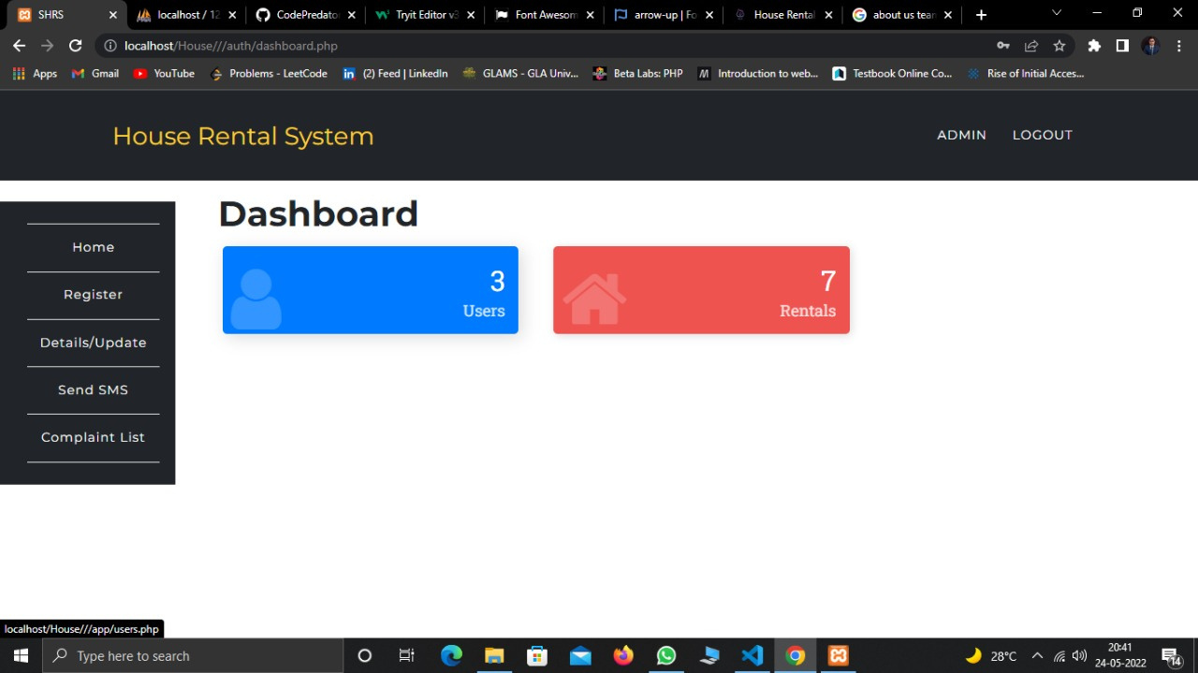

Slide 5
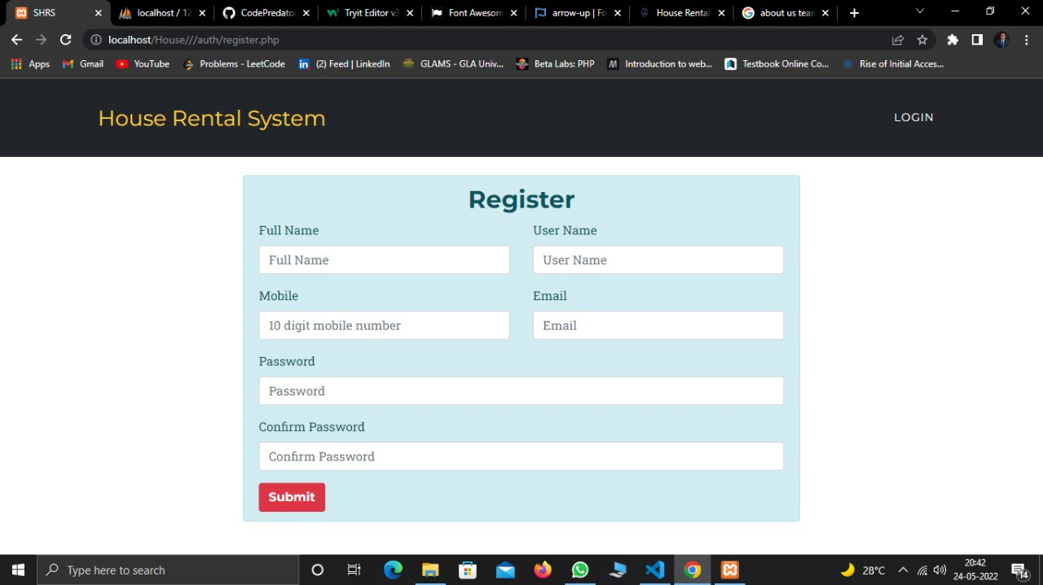

Slide 6
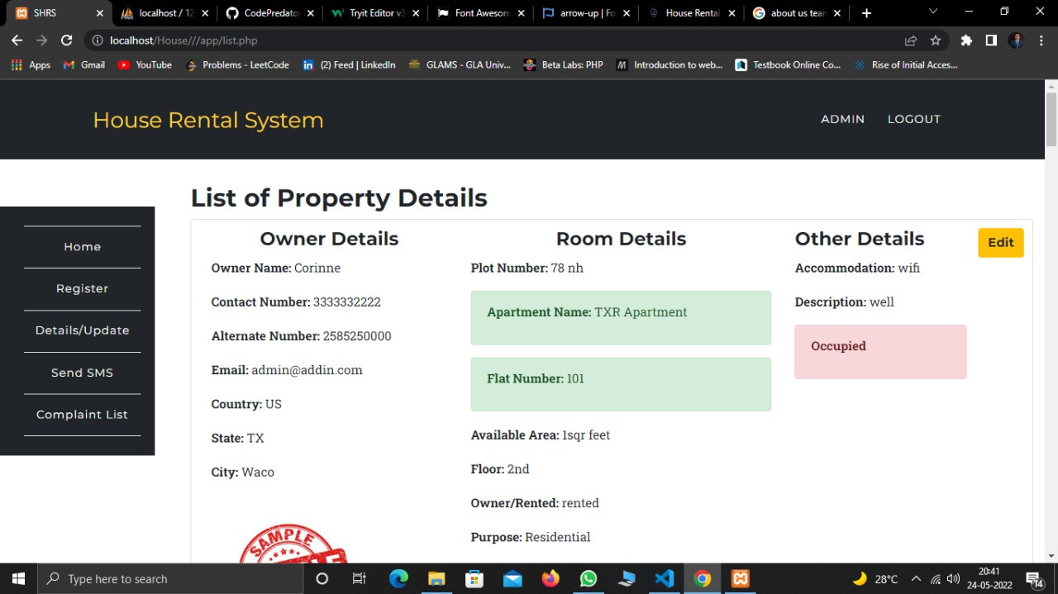

Slide 7
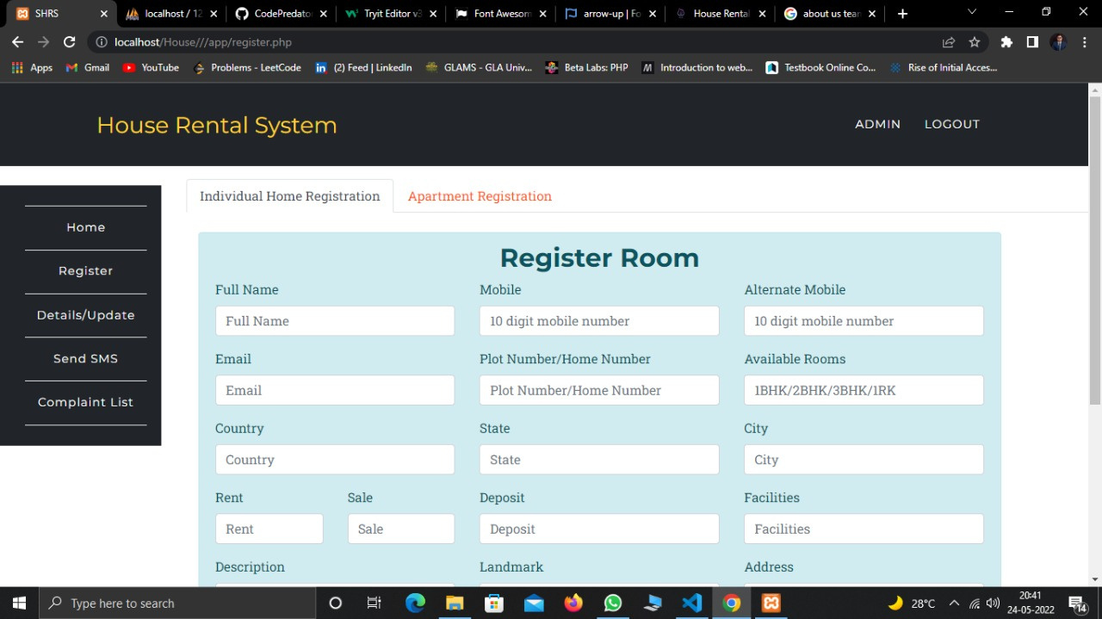

Slide 8
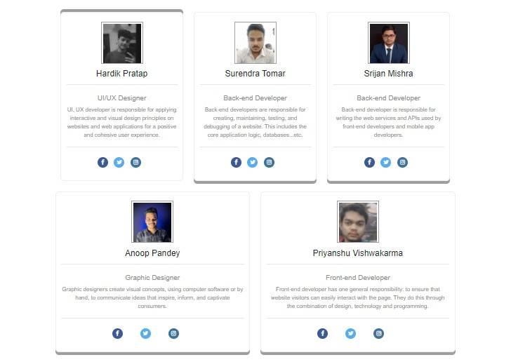

Slide 9
Submitted to:
Mr. Piyush Vashisth
Submitted By:
Srijan Kumar(191500823)
Priyanshu Viswakarma(191500611)
Anoop Kumar Pandey(191500127)
Hardik Pratap(191500310)
Surendra Pratap Tomar(191500831)

Slide 10
Thank
you!

